Slide 1

Bacterial Toxins
2nd Year – 1st semester
Dr.Munira Ch. AL-Abadi

Slide 2
Bacterial Toxins:
Many bacteria produce toxins, enzymes and pigments. Toxins and enzymes play important role in pathogenecity. Toxins are of two types:
1-Proteins:may be released into the extracellular environment of pathogenic bacteria.
Most of the protein toxins are thought of as exotoxins,since they are released from the bacteria and act on host cells at adistance.
2- Lipopolysaccharides(LPS):are associated with the cell walls of Gram-ve bacteria.
The (LPS) component of the Gram-ve bacteria outer membrane bears the name endotoxin because of its association with the cell wall of bacteria.

Slide 3
Exotoxins:
Many bacteria produce proteins (exotoxins) that modify, by enzymatic action,or otherwise destroy certain cellular structures. Effects of exotoxins are usuallyseen acutely, since they are sufficiently potent that serious effects (e.g. death)often result. Examples of this are botulism, anthrax, cholera and diphtheria. Ifthe host survives the acute infection, neutralizing antibodies (anti-toxins) areoften elicited that neutralize the affect of the exotoxin.
Characters of Exotoxin:
-The protein toxins(Exotoxins) are soluble proteins secreted by living bacteria during exponential growth.
-The production of exotoxins is specific to a particular bacterial species(e.g. only Clostridium tetani produces Tetanus toxin; only Corynebacterium diphtheria produces the Diphtheria toxin).
-

Slide 4
Usually,vitulent strains of the bacterium produce the toxin(or range of toxins),while non-virulent strains donot.
-Toxin is the major determinant of virulence.
-Both Gram-positive and Gram-negative bacteria produce soluble protein toxins.
-Many exotoxins ,consist of two components: subunit A(responsible for the enzymatic activity of the the toxin),subunit B(concemed with binding to aspecific receptor on the host cell membrane and transferring the enzyme across the membrane

Slide 5
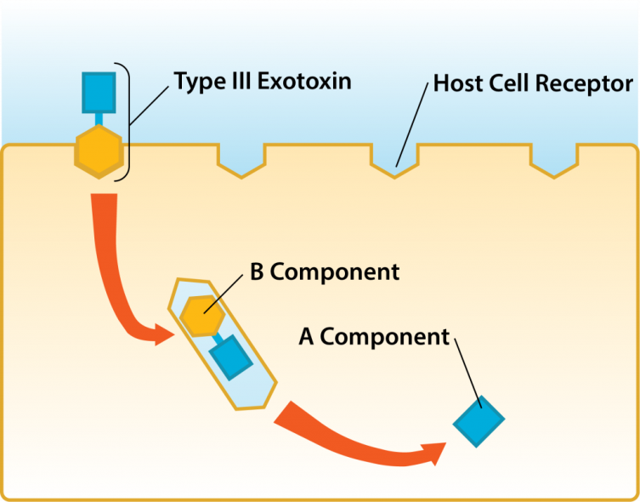
AB-toxin: Host Cell Binding.

Slide 6
Exotoxins ,denatured by heat,acid,proteolytic enzymes.
-Exotoxins are highly specific in the substrate utilized in their mode of action,usually the site of damage caused by the toxin indicates the location of the substrate for the toxin.
Terms such as:Enterotoxin,Neurotoxin,Leukocidin,Hemolysin:are used to indicate the target site of some well-defined protein toxins.
-Protein toxins are strongly antigenic,unstable ,they lose their toxic properties(Toxoid),but retain their antigenic ones.
Toxoids: are detoxified toxins which retain their antigenicity and their immunizing capacity (first discovered by Ehrlich).

Slide 7
Endotoxins:
Endotoxins are toxic components of the bacterial cell envelope. The classicaland most potent endotoxin is lipopolysaccharide. However, peptidoglycandisplays many endotoxin-like properties. Certain peptidoglycans are poorlybiodegradable and can cause chronic as well as acute tissue injury. Endotoxinsare “non-specific” inciters of inflammation.

Slide 8
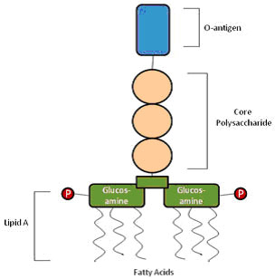
.
Endotoxin structure.

Slide 9
-Lipopolysaccharides(LPS)participates:
In a number of outer membrane functions essential for bacterial growth and survival,especially within the context of ahost-parasite ineraction.
-Endotoxin complex associated with the outer envelope of Gram- negativebacteria such as:Salmonella,Shigella,Pseudomonas,Neisseria,and
Other leading pathogens.
-The biological activity of endotoxin is associated with the lipopolysaccharides.
-Toxicity is associated with the lipid component (lipid A).
-Immunogenicity(antigenicity) is associated with the polysaccharide components.

Slide 10
-The cell wall antigens (O-antigens) of Gram-negative bacteria are components of LPS.
-Endotoxins are less potent than exotoxins,and less specific in their action,since they do not act enzymatically.
-Endotoxins are heatstable (boiling for 30 min.).
-Endotoxins,although strongly antigenic,cannot be converted to toxoid.

Slide 11
-Lipopolysaccharides(LPS)participates:
In a number of outer membrane functions essential for bacterial growth and survival,especially within the context of ahost-parasite ineraction.
-Endotoxin complex associated with the outer envelope of Gram- negativebacteria such as:Salmonella,Shigella,Pseudomonas,Neisseria,and
Other leading pathogens.
-The biological activity of endotoxin is associated with the lipopolysaccharides

Slide 12


